Slide 1



SOFTWARE DEVELOPMENT PROFESSIONAL PROGRAM
Creating & Removing DOM Elements

Slide 2





Creating & Removing DOM Elements
Learning Objectives
Create and modify DOM elements.
Append DOM elements to a page.
Remove DOM elements from a page.

Slide 3

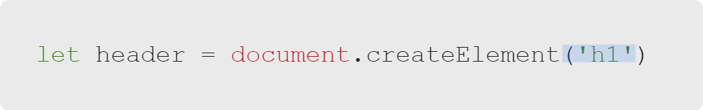
Creating & Removing DOM Elements
document.createElement Arguments
Pass a tag name as a string.
Notes:
<<Exercise 01--creating DOM elements>>

Slide 4
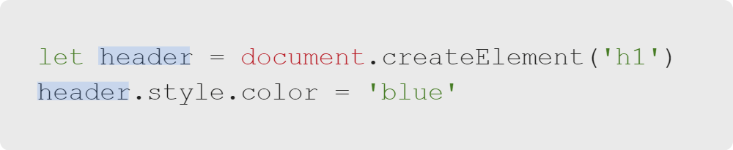

Creating & Removing DOM Elements
document.createElement Return Value
An empty DOM element is returned:
Notes:
We'll usually want to save that element to a variable so we can modify it.
One example would be by manipulating the styles of the element, as we did in the previous lesson using
"querySelector".

Slide 5


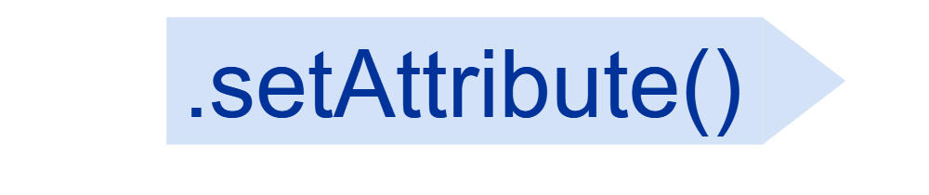
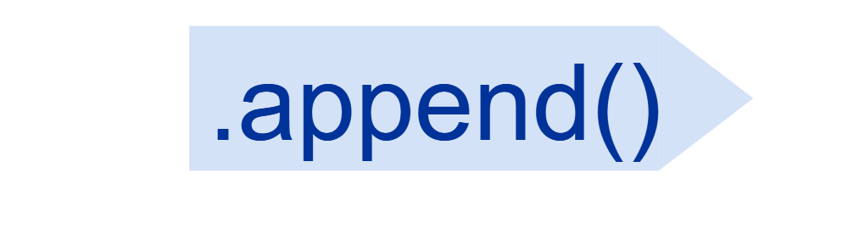
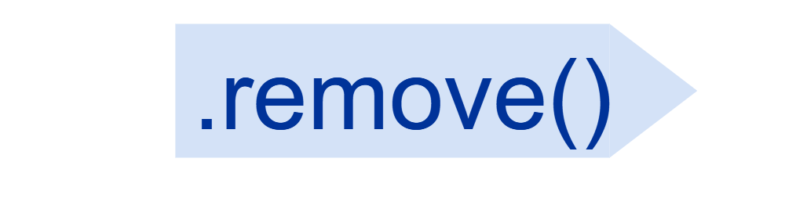
Creating & Removing DOM Elements
DOM Element Methods
element
Notes:
In this lesson, we'll learn four new methods for DOM elements;
these methods are particularly useful when creating elements.

Slide 6

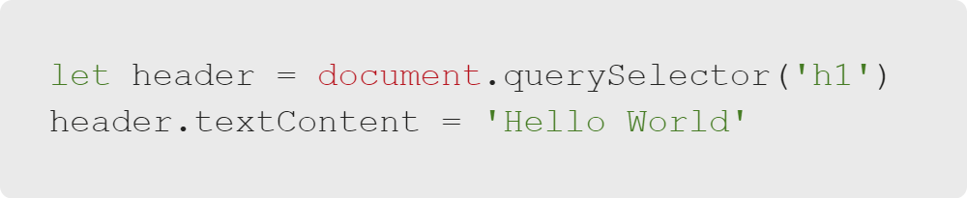

Creating & Removing DOM Elements
element.textContent
Notes:
"element.textContent" is a property (we set it; we don't call it) that allows us to change the text inside of an element.

Slide 7
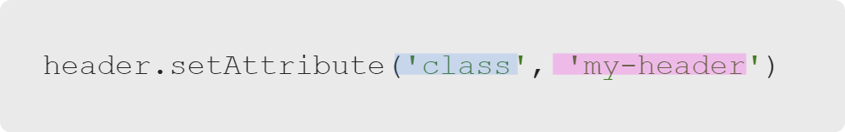
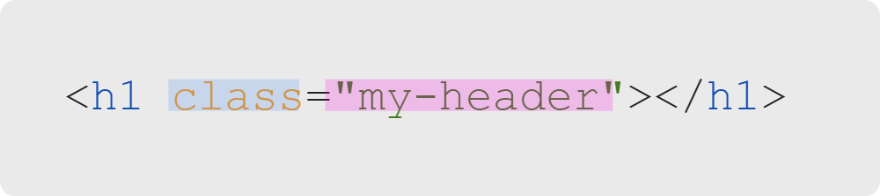
Creating & Removing DOM Elements
element.setAttribute
JavaScript
Takes two arguments:
The attribute name
The attribute value
Resulting HTML
Notes:
"element.setAttribute" allows us to change HTML attributes (like class or href).
setAttribute accepts an attribute name as its first argument, and its value as the second argument.
<<Exercise 02--set "target" and "href" attributes of an "a" tag>>

Slide 8

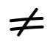
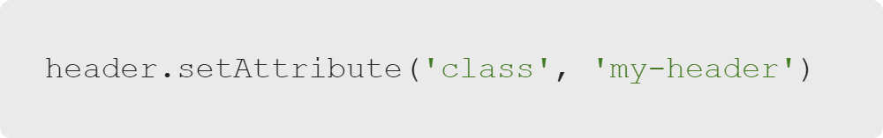
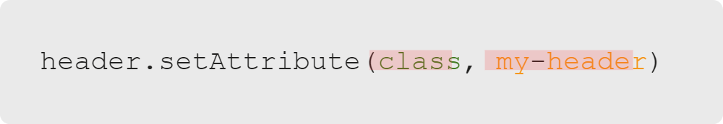
Creating & Removing DOM Elements
Warning
Remember to pass attribute names and values as strings.
This will work.
This will not.
Notes:
An important reminder from a previous lesson. Forgetting the quotes is an easy way to make JavaScript throw errors.
Without the quotes to signify we have a string, JavaScript tries to interpret this as a variable and fails.

Slide 9
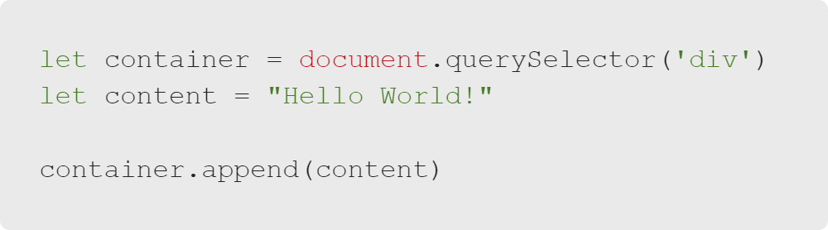

Creating & Removing DOM Elements
element.append
Notes:
The .append method adds content to a DOM element.
<<Exercise 03--append text content to an "a" tag>>

Slide 10
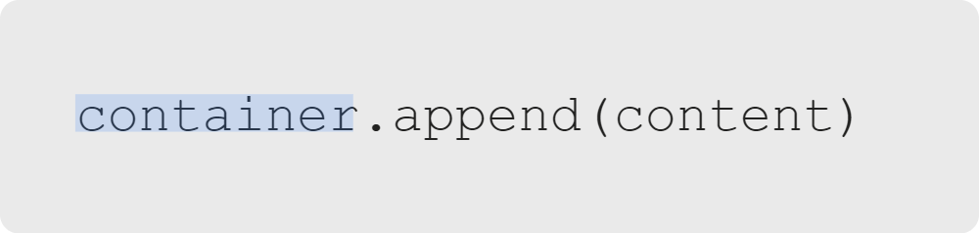
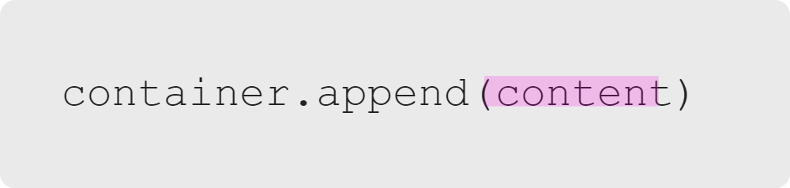
Creating & Removing DOM Elements
Calling .append and .append Arguments
Call .append on the element you want to add content to:
Pass .append the content you want added:

Slide 11
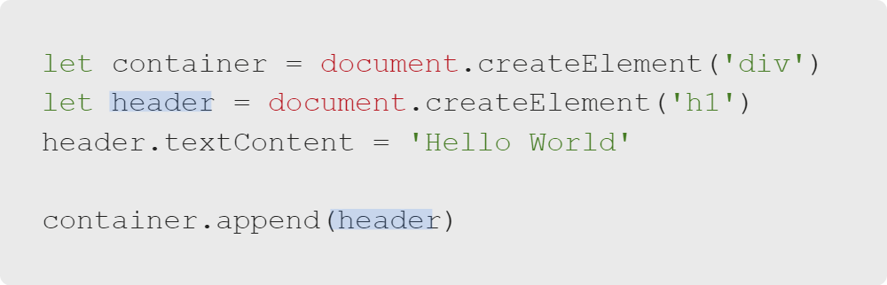
Creating & Removing DOM Elements
Appending Nested Elements
Notes:
Or even references to other elements!
<<Exercise 04--create list items with content then add them to a list element>>

Slide 12

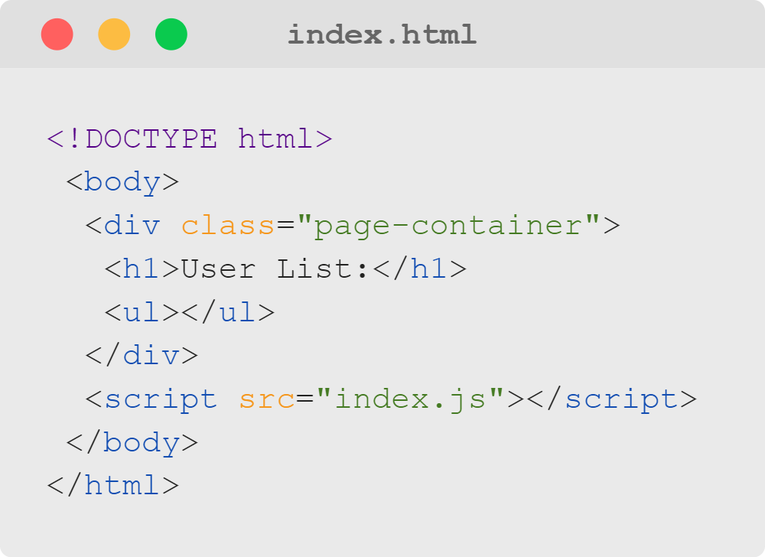
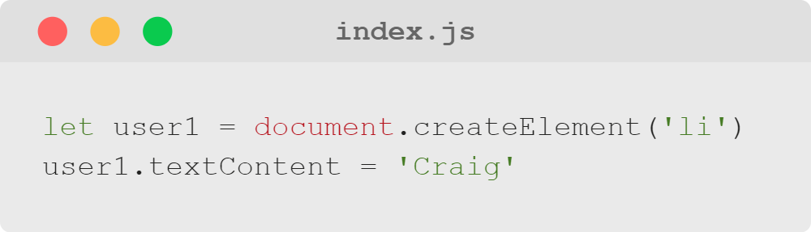
Creating & Removing DOM Elements
Question
Where do you think Craig would appear in the HTML below?
Notes:
It wouldn't; the user1 li element hasn't been appended anywhere yet...
We've created an 'li' element, and added text to it, but we haven't put it into the DOM yet.
We need to specify where in the DOM our new element belongs, otherwise it lives only in our JavaScript.

Slide 13


Creating & Removing DOM Elements
Element Visibility
Elements aren't visible until they're appended to something already within the document body.
But we can work on them before appending them.
Like a ship in dry dock.

Slide 14
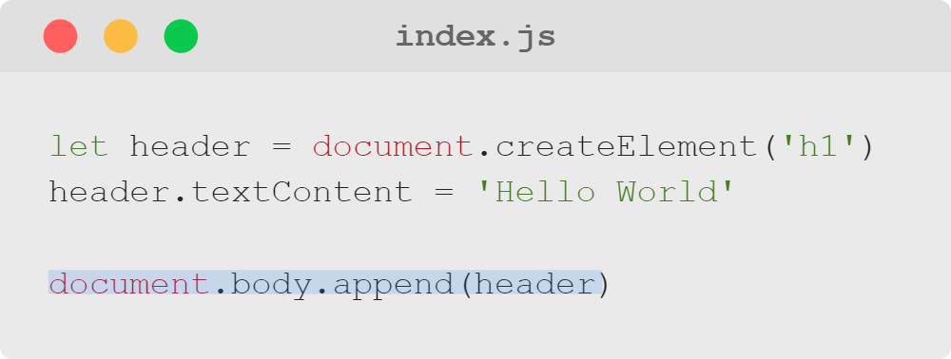
Creating & Removing DOM Elements
Appending to the Body
Where on the page does the header get added?
Notes:
If we want to add an element to the end of the page, we can always append to the document body.
But often, we'll want to add to another element, already on the page...

Slide 15
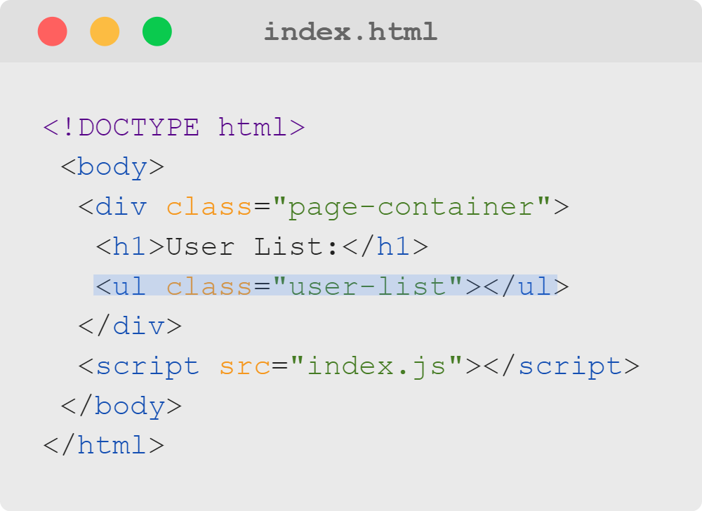
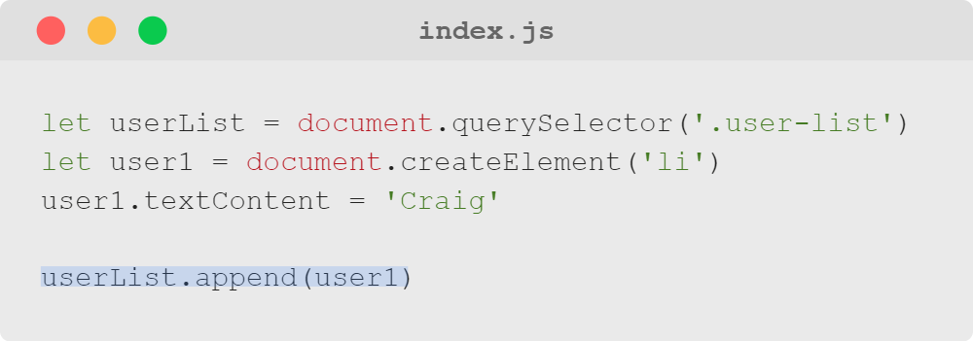
Creating & Removing DOM Elements
Appending to the Page
Notes:
...like the user list from our question a moment ago.
The HTML on the right represents the HTML file, NOT the DOM after index.js is run.
<<If students are ready, you can explain that the DOM is a programming interface that represents the page
so that programming languages (like JavaScript) can interact with it;
it doesn't change the HTML file directly which is why the HTML displayed on the developer tools console is
often so different from the HTML displayed when you inspect the source (like the Facebook example earlier).>>
Here is a working example of adding the li to the user list; let's go through it step by step.

Slide 16
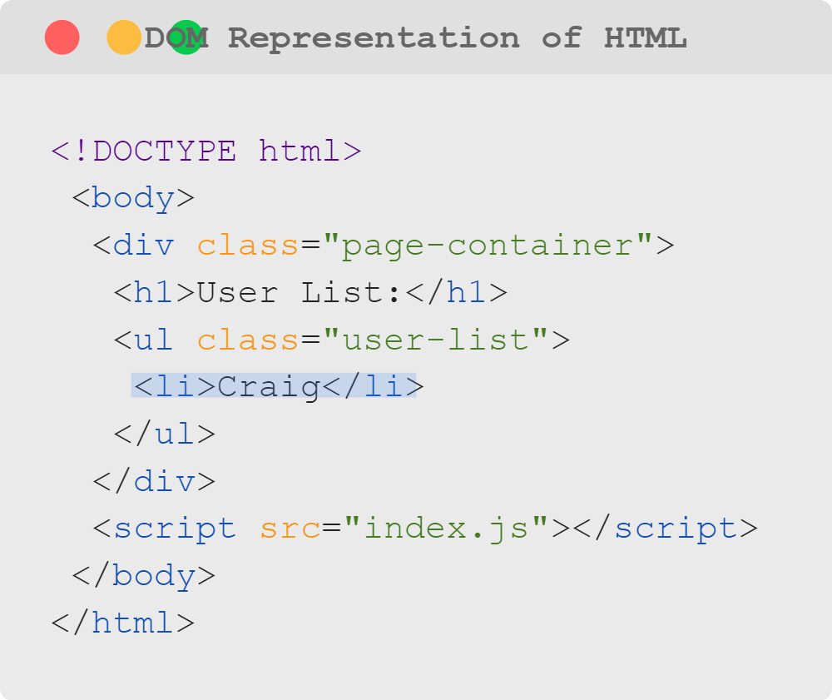
Creating & Removing DOM Elements
Appending to the Page
Notes:
Here is a working example of adding the li to the user list and what the DOM will look like after the
JavaScript runs; let's go through it step by step.

Slide 17
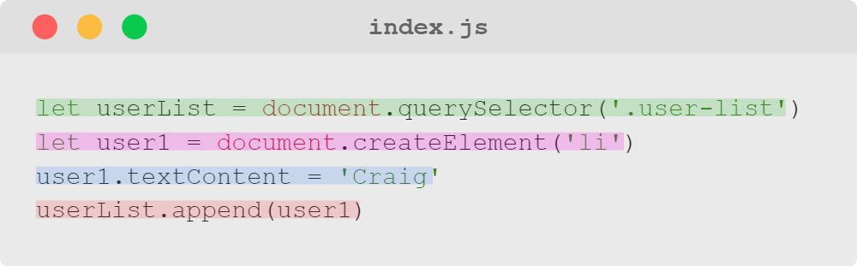
Creating & Removing DOM Elements
Step by Step Example
Select an element already on the page.
Create a new "li" element.
Add content to the "li" element.
Add the "li" element to element we selected from the page.
Notes:
Note that the first step is selecting the element with class of 'user-list' from the example on a prior slide
('<ul class="user-list"></ul>').
After completing the four steps, the li element with text content of Craig should be appended to the element
selected in step 1 ('<ul class="user-list"><li>Craig</li></ul>').
<<Ideally demo this for learners to see each step in action.>>

Slide 18
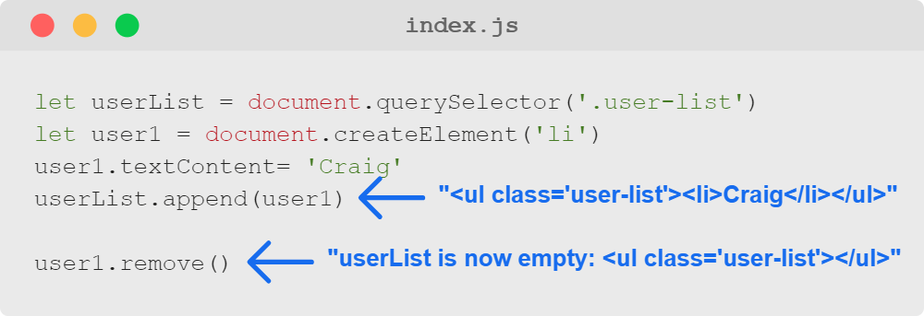
Creating & Removing DOM Elements
Removing Elements
Notes:
The method element.remove will remove an element from the page, wherever it is currently appended.
<<Exercise 05--remove a DOM element>>

Slide 19
Creating & Removing DOM Elements
Summary
What We've Covered:
Creating & Removing DOM Elements
Creating an Element
Element Methods: Setting Text Content
Element Methods: Setting Attributes
Adding and Removing Elements
Let's practice creating and removing DOM elements to make a dynamic profile page.

